Slide 1

WAY TO ENTERPRISE
Advanced Java
VTI ACADEMY
Author: duy.nguyenngoc1@vti.com.vn
March 2020

Slide 2
Agenda
Enum
Generator
Primary Key
Assignments
Copyright © VTI Academy All Rights Reserved

Slide 3
Enum
2 ways
Using @Enumerated
Ordinal value
String value
Using @Converter

Slide 4
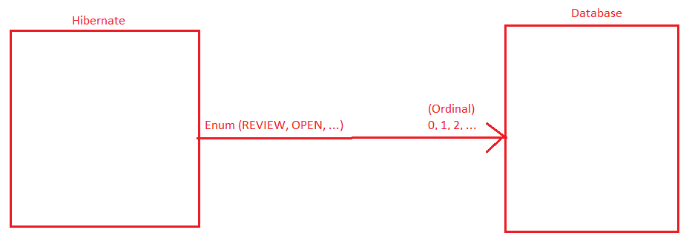
Enum
Ordinal value

Slide 5
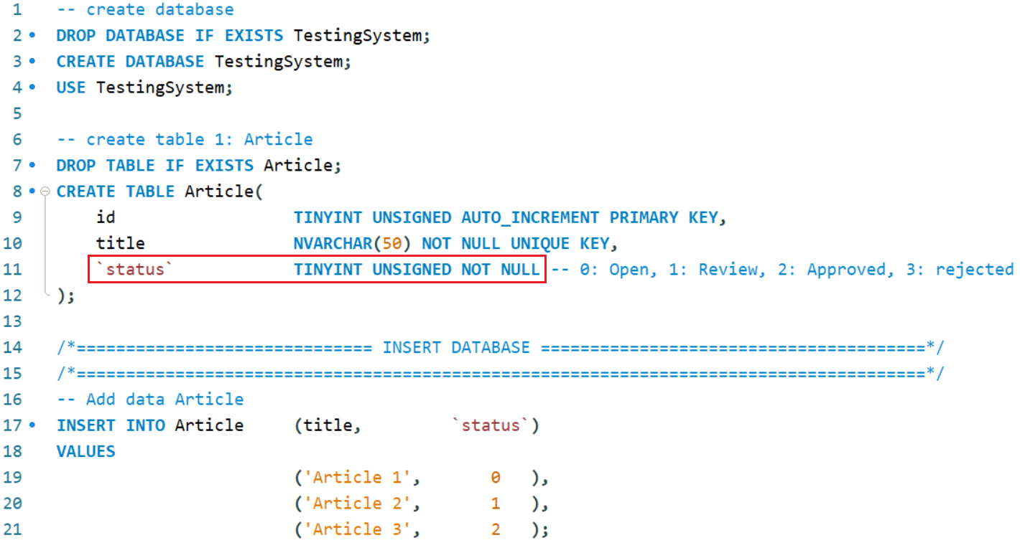
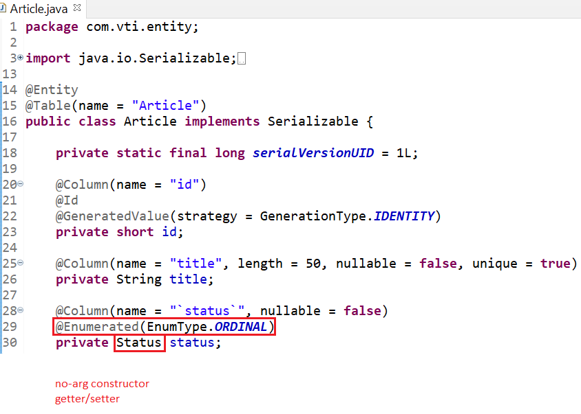

Enum
Entity
Enum

Slide 6
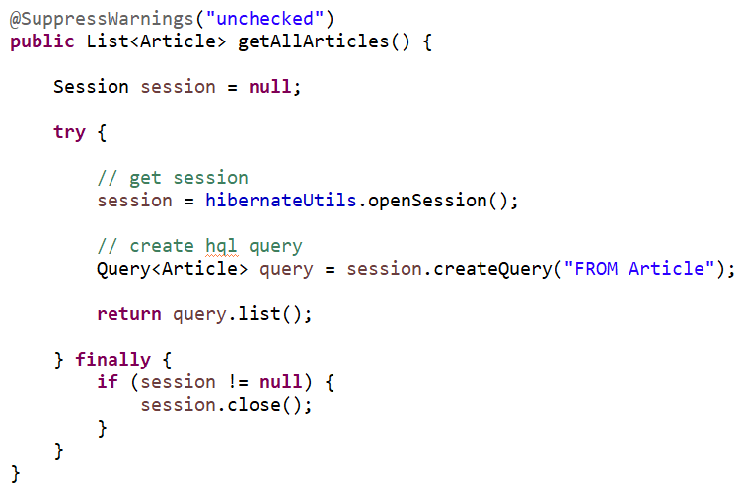
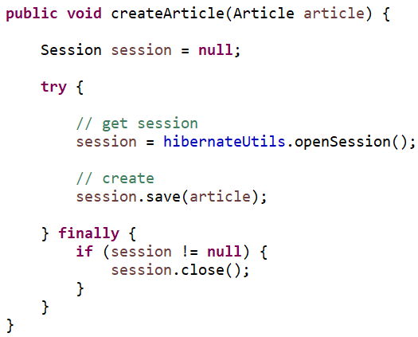
Enum
Repository

Slide 7
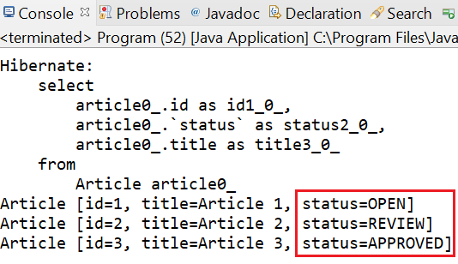
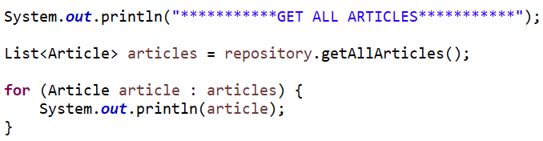
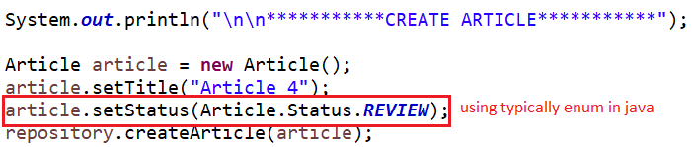
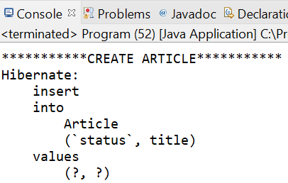
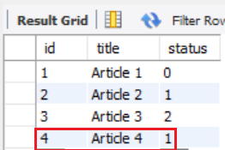
Enum
Mapping enum in Java
REVIEW (in Java) → 1 (in SQL)

Slide 8
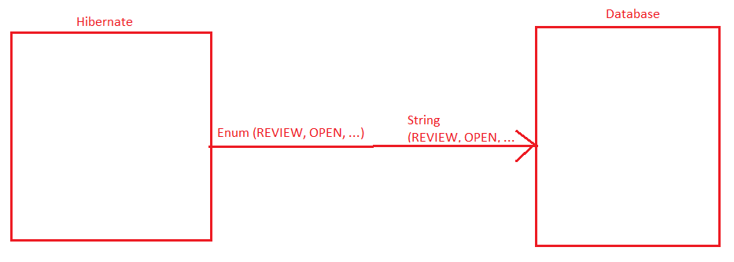
Enum
String value

Slide 9
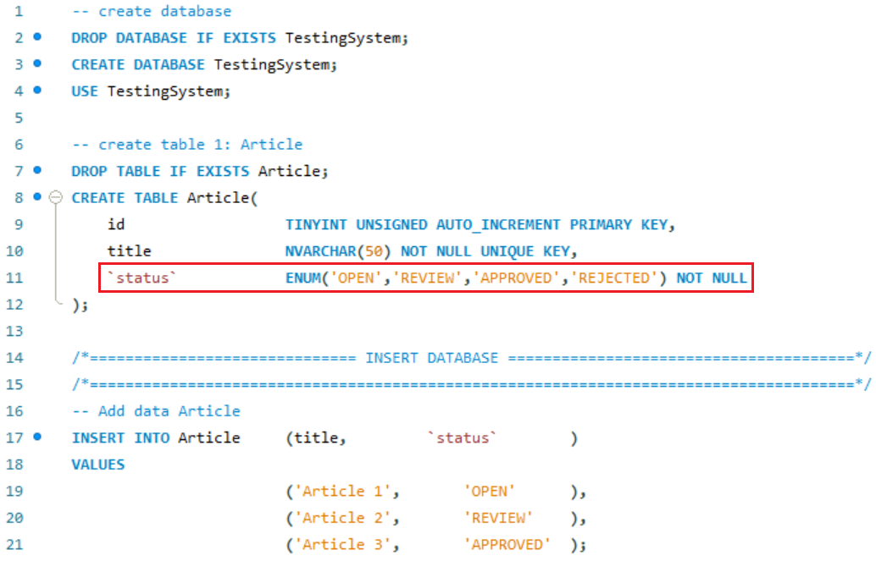
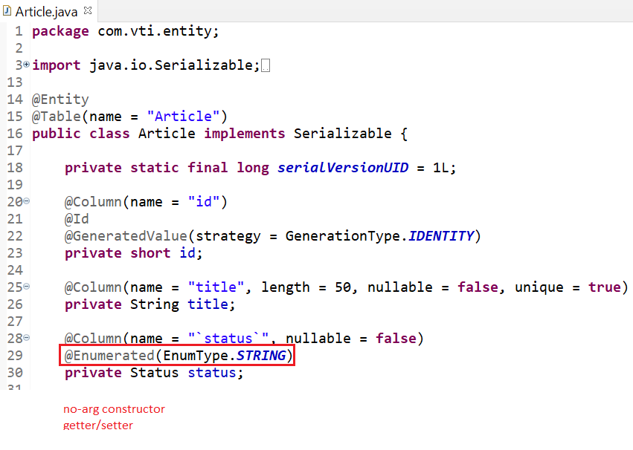
Enum
Entity
Enum

Slide 10
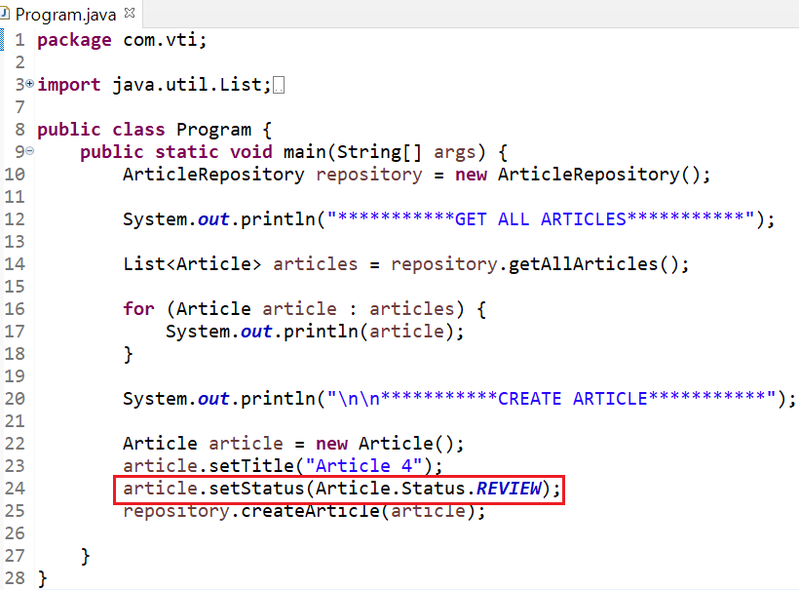
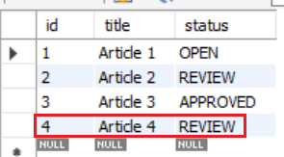
Enum
REVIEW (in Java) → REVIEW (in SQL)

Slide 11
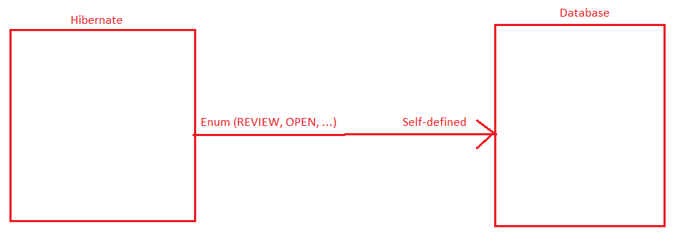
Enum
@Converter

Slide 12
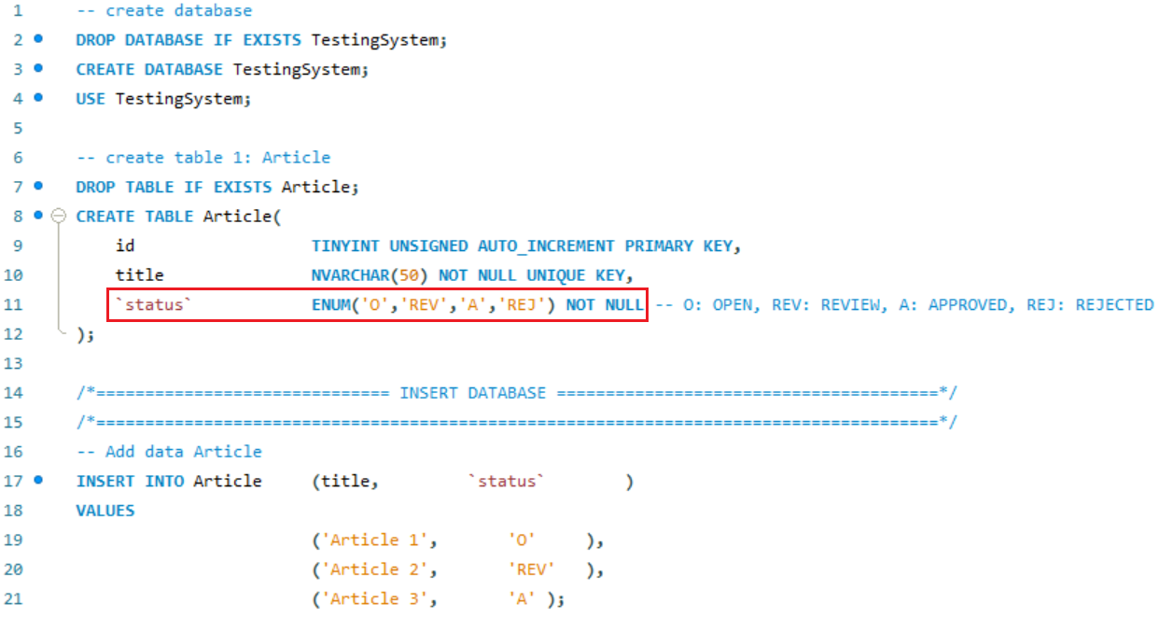
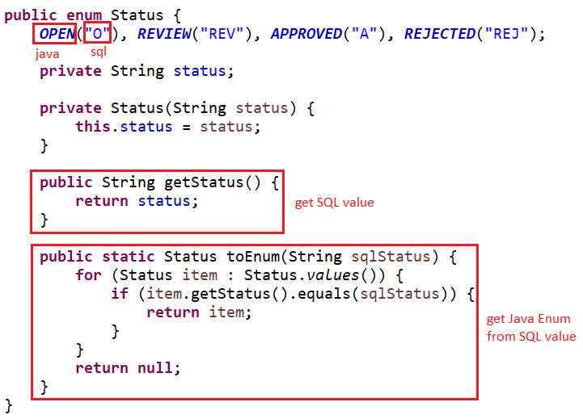
Enum
Enum

Slide 13
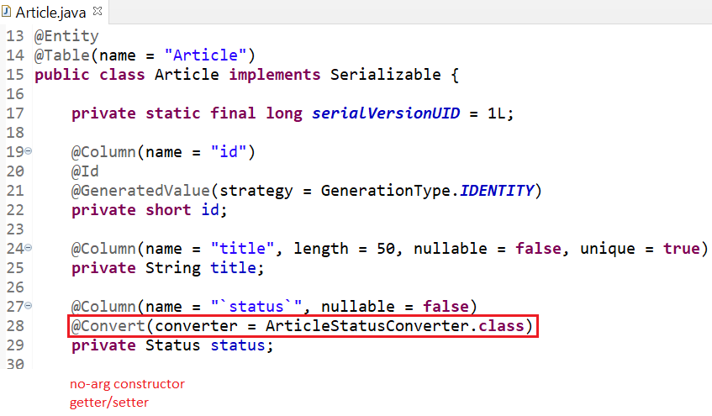
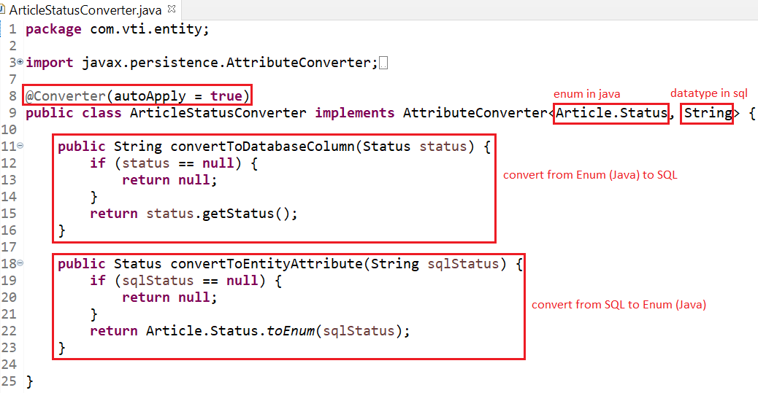
Enum
Entity
Converter File

Slide 14
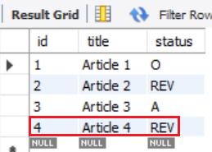
Enum
REVIEW (in Java) → REV (in SQL)

Slide 15

Testing System Assignment

Slide 16
Generator
@GeneratedValue(strategy, generator)
GenerationType.IDENTITY
GenerationType.SEQUENCE
GenerationType.AUTO (default)
Custom Generator

Slide 17
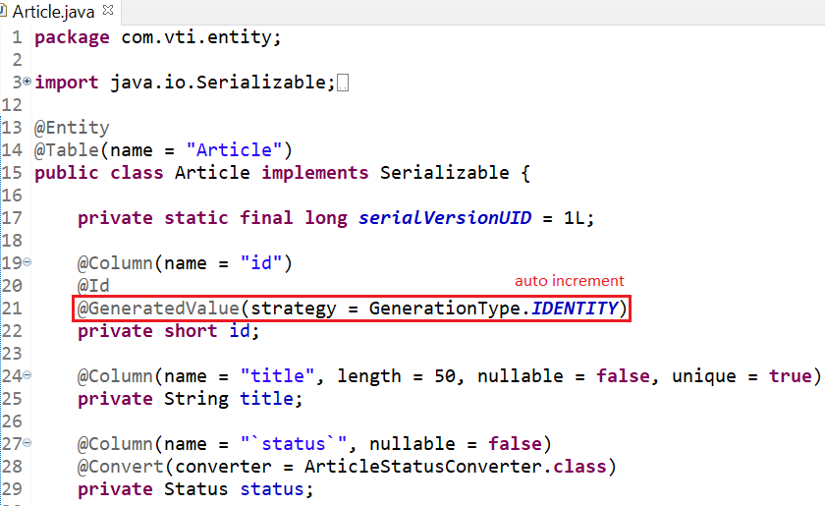
Generator
GenerationType.IDENTITY: auto increment

Slide 18
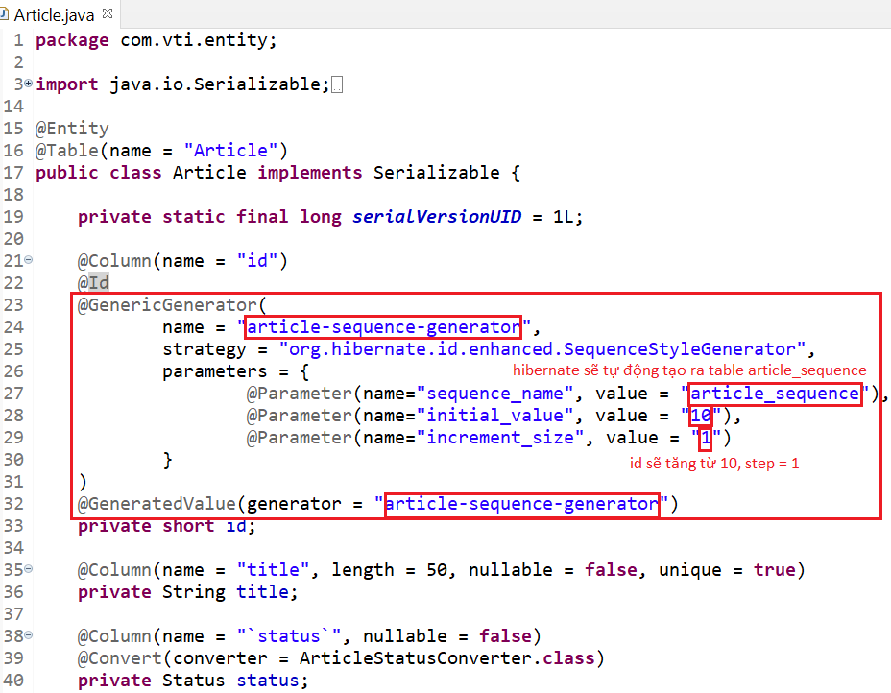
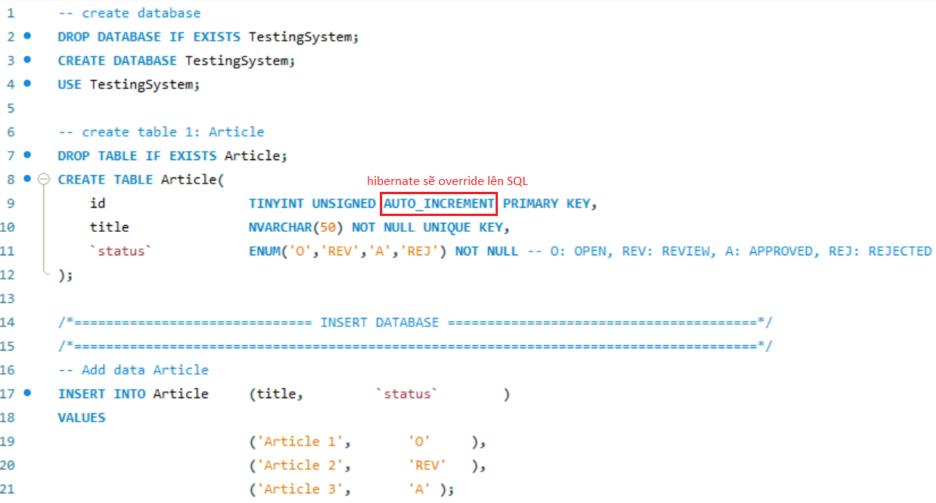
Generator
GenerationType.SEQUENCE: The id will increase sequentially
Entity

Slide 19
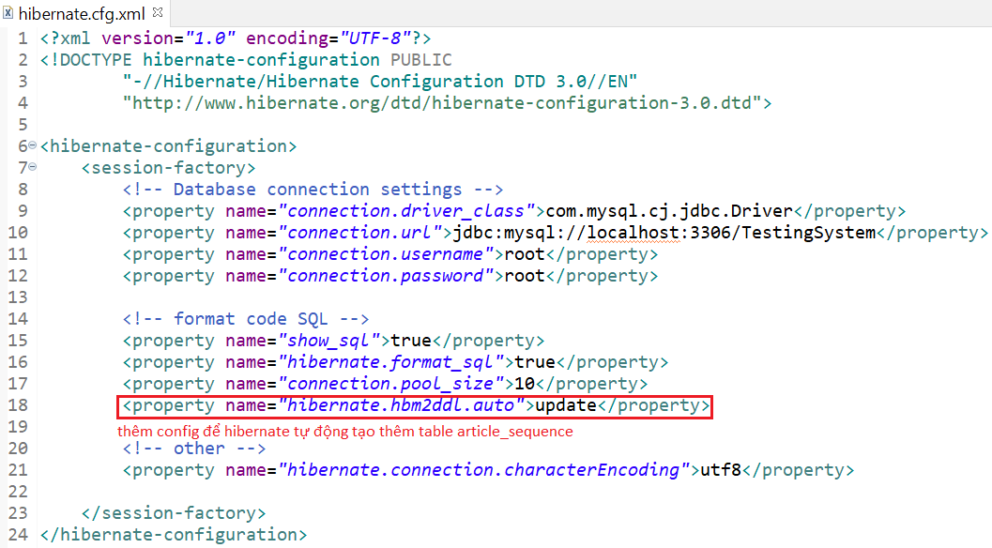
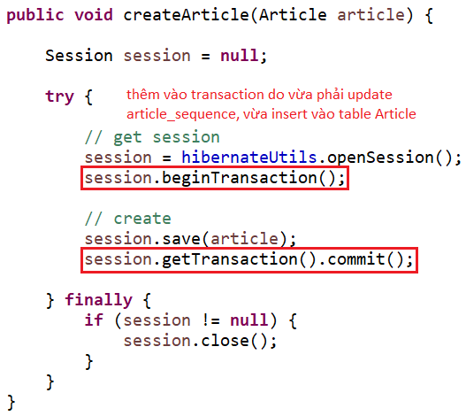
Generator
Config
Repository

Slide 20
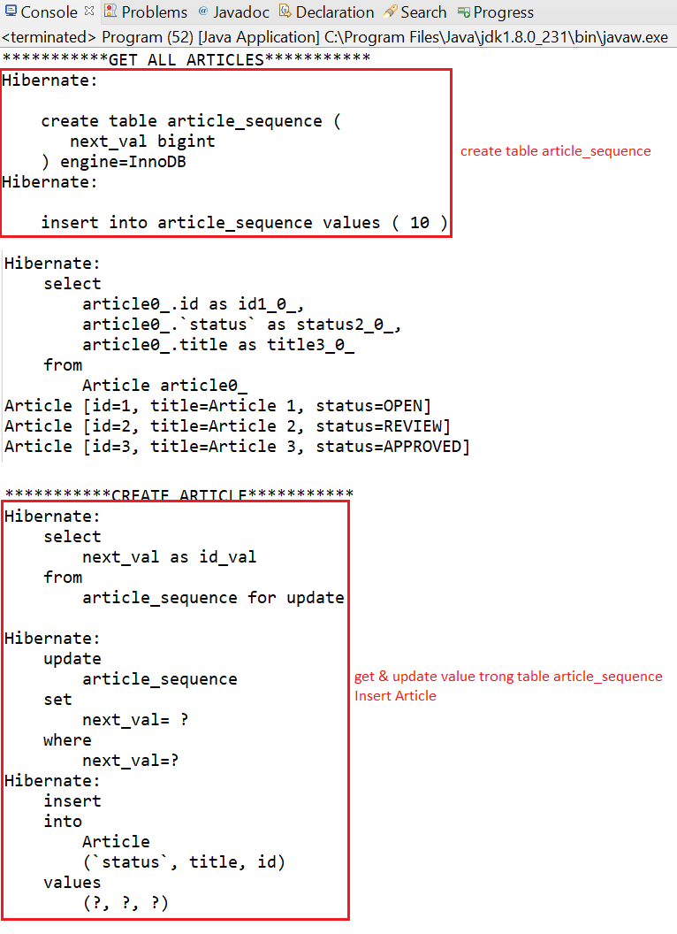
Generator

Slide 21
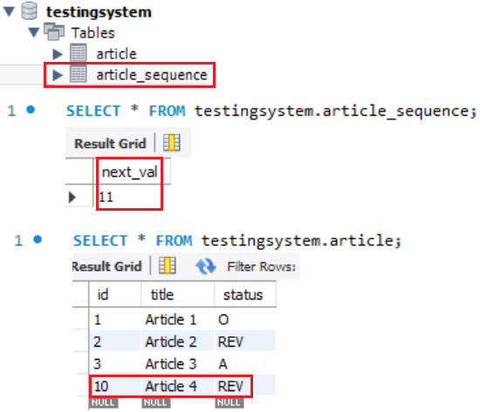
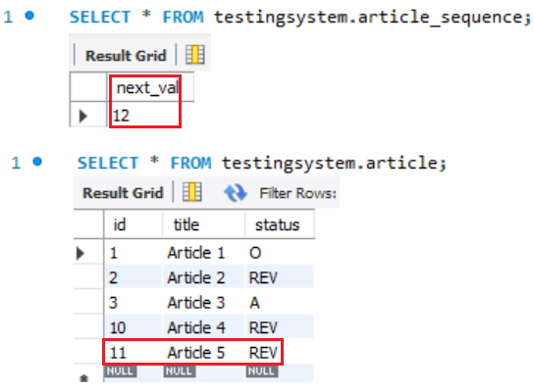
Generator
Primary key generation will start at 10 with step = 1

Slide 22
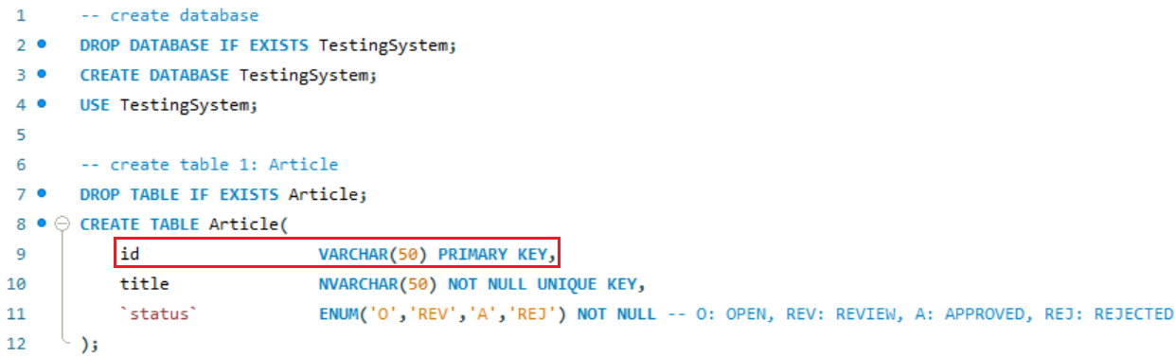
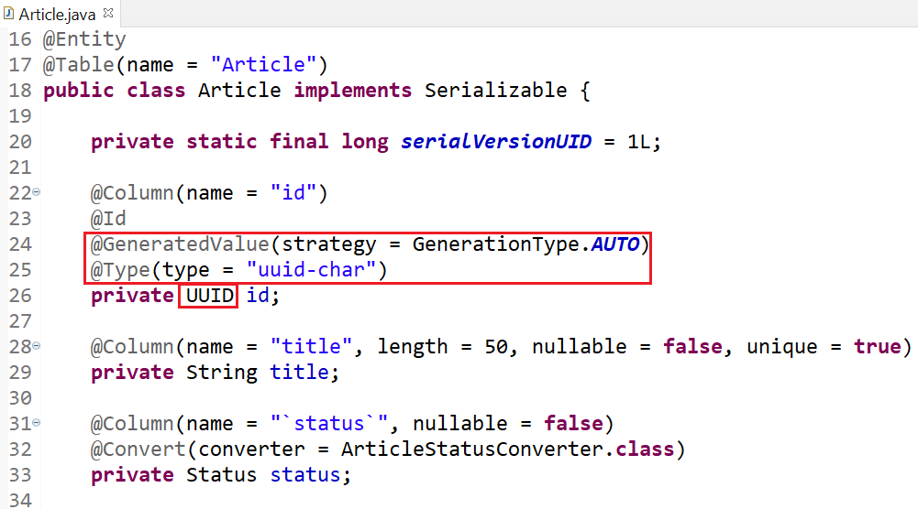
Generator
GenerationType.AUTO (default): The id will generate UUID
Entity

Slide 23
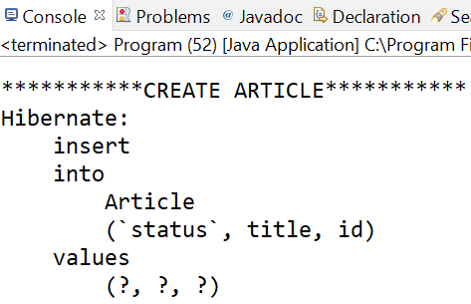
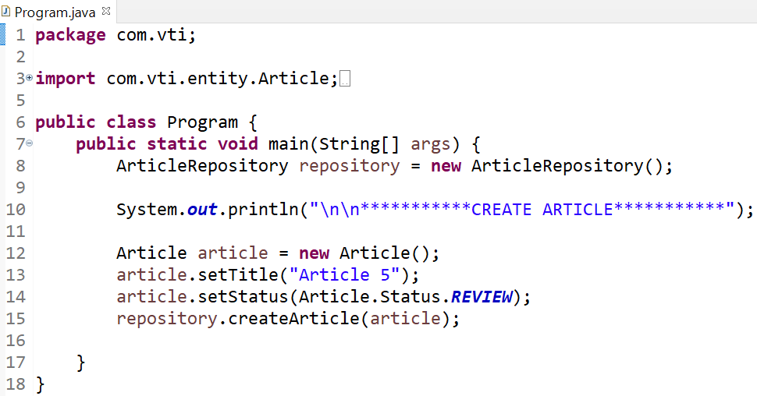
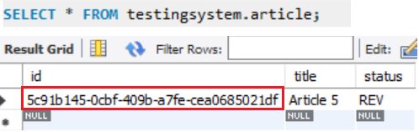
Generator

Slide 24
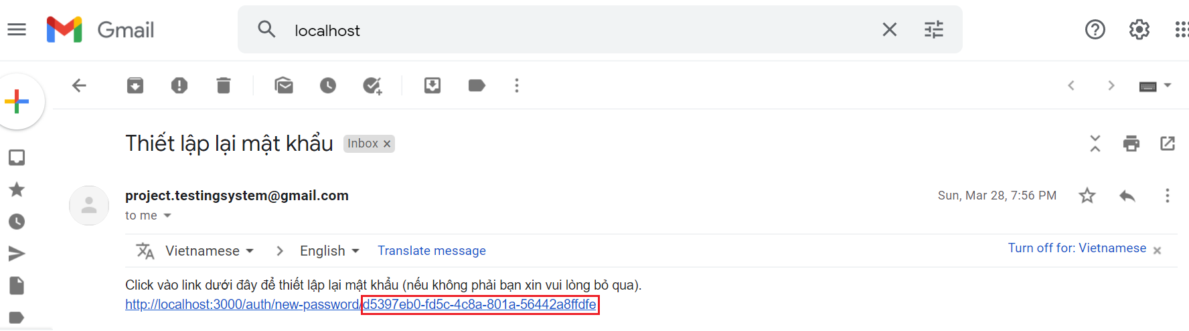
Generator
UUID using for id application, token for reset password, ...

Slide 25
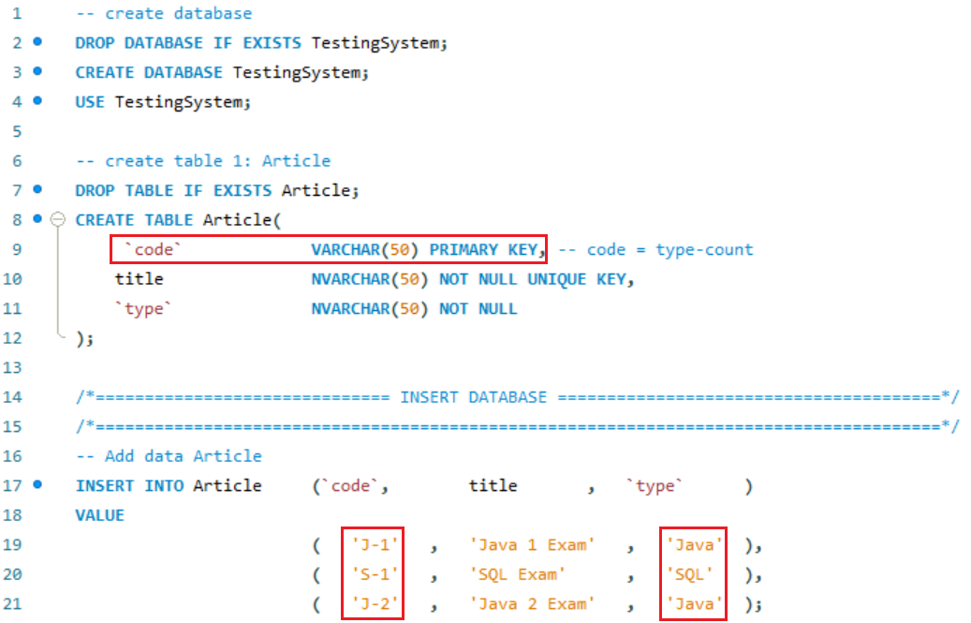
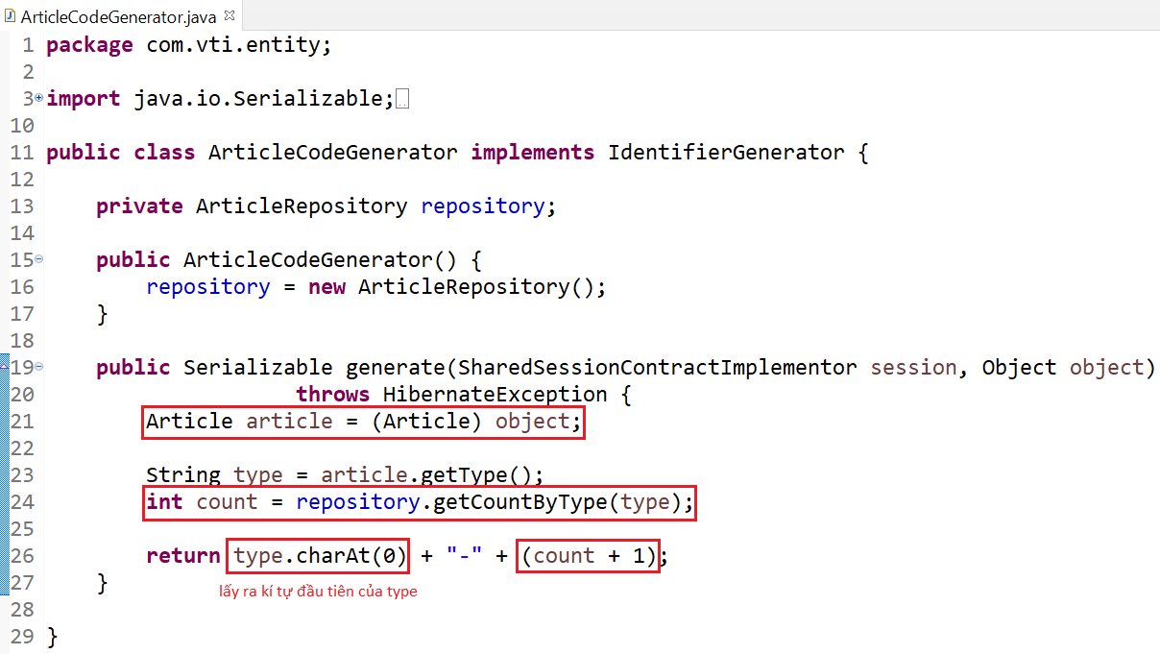
Generator
Custom generator
Generator file

Slide 26
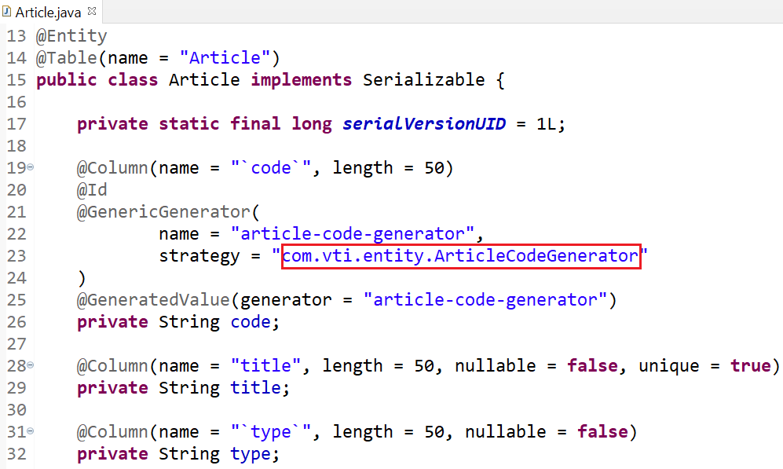
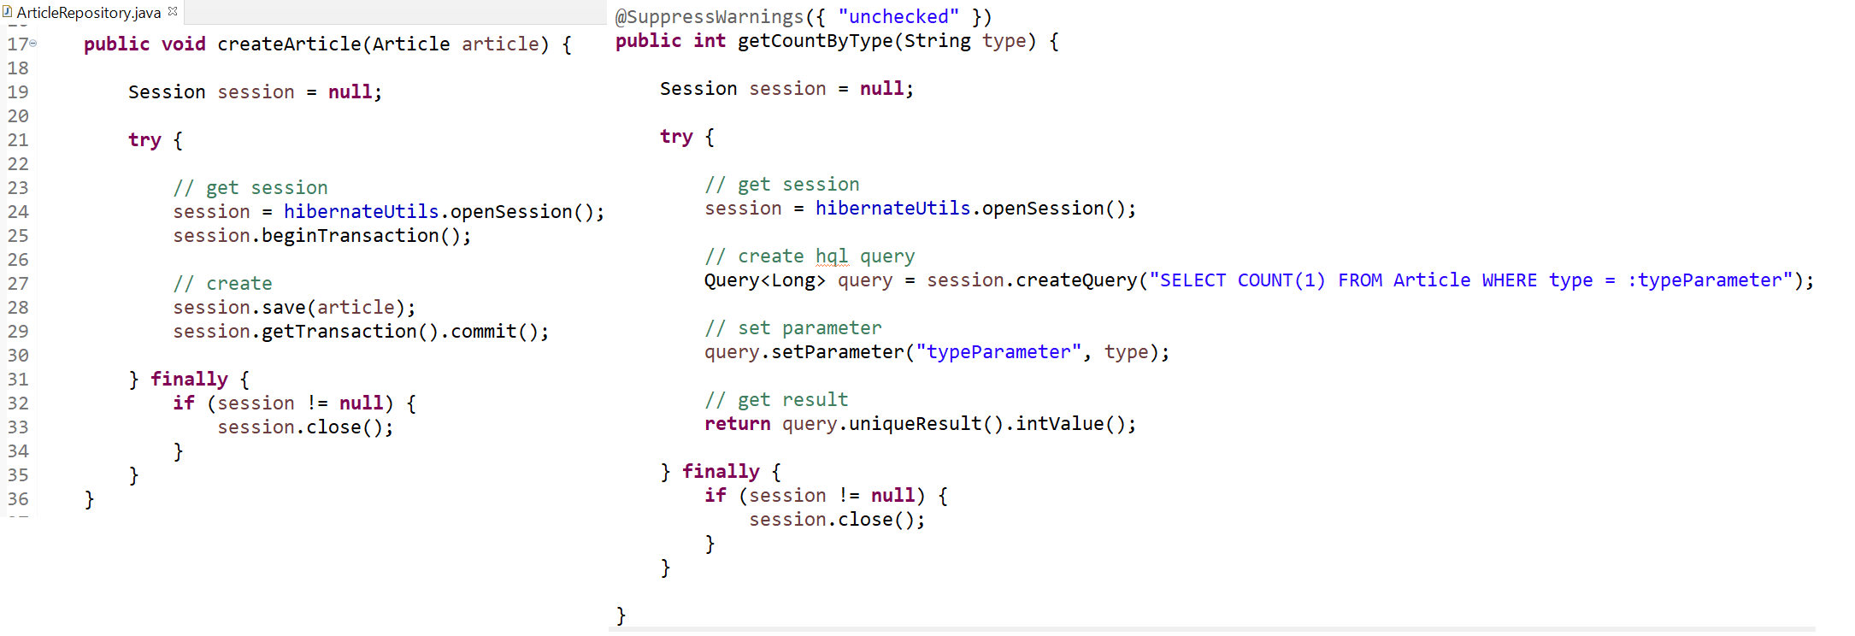
Generator
Entity
Repository

Slide 27
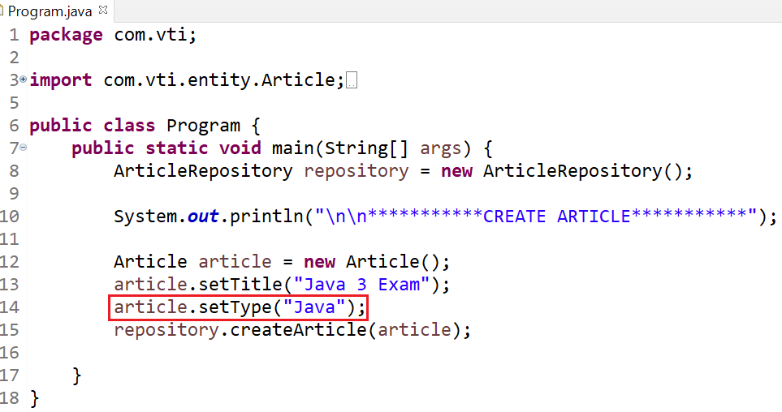
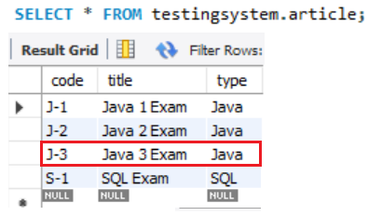
Generator
code = type-count

Slide 28

Testing System Assignment

Slide 29
Primary key
Single primary key
Multiple primary key
Way 1: @Embeddable & @EmbeddedId
Way 2: @Embeddable & @IdClass

Slide 30
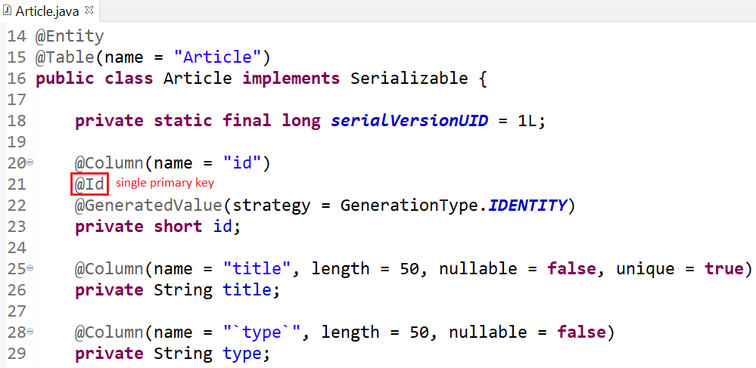
Primary key
Single primary key
@Id: Define single id of database’s table

Slide 31
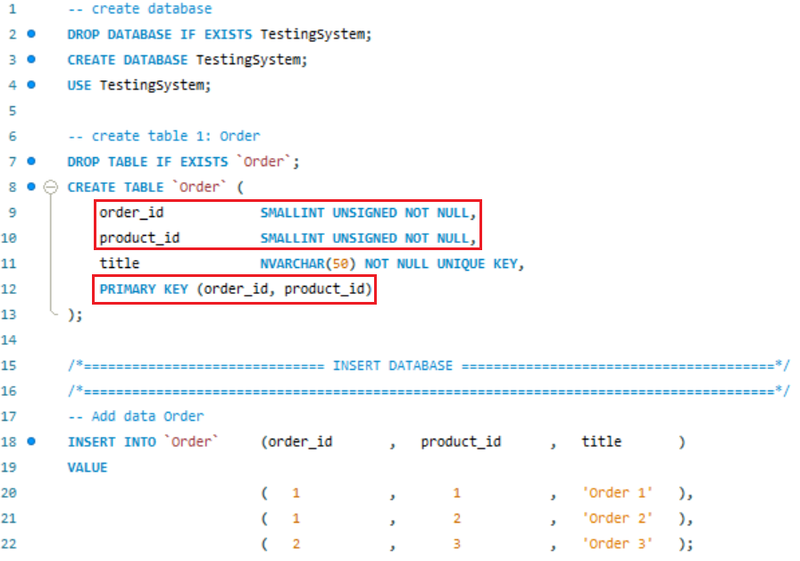
Primary key
Multiple primary key
Way 1: @Embeddable & @EmbeddedId

Slide 32
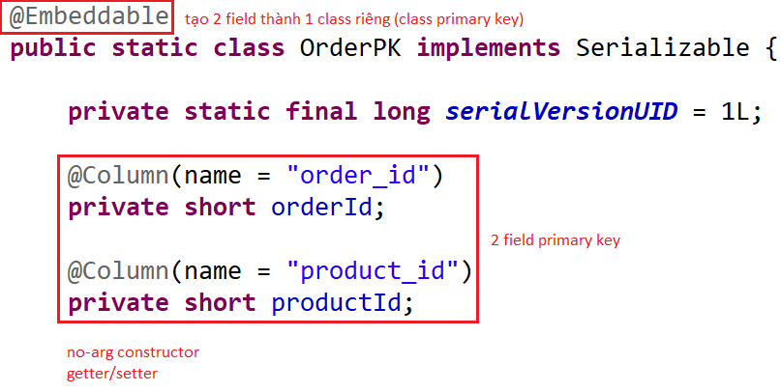
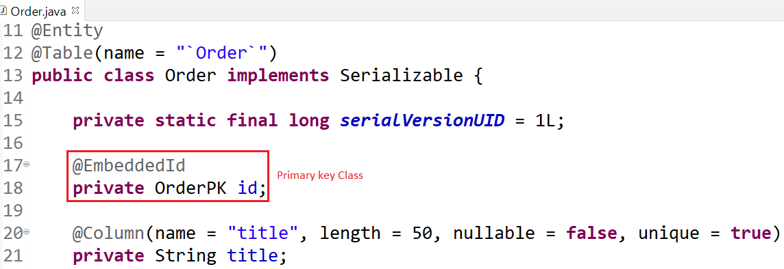
Primary key
Primary key Class
Using

Slide 33
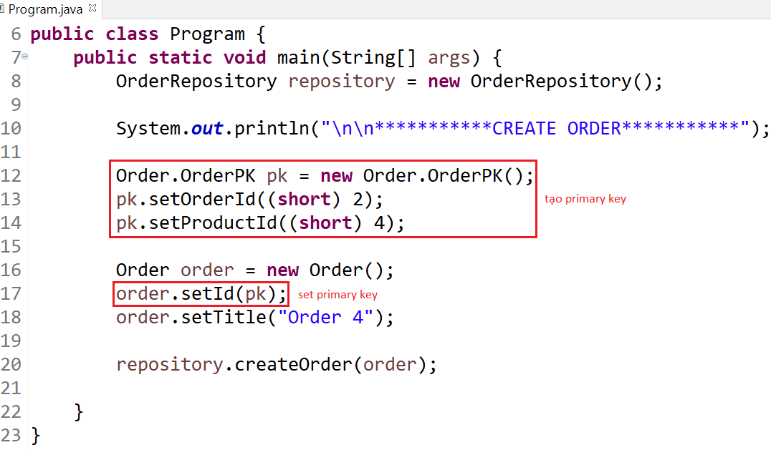
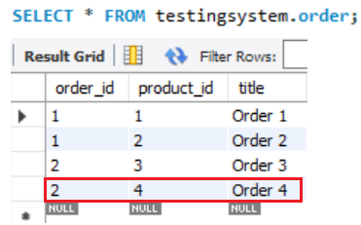
Primary key

Slide 34
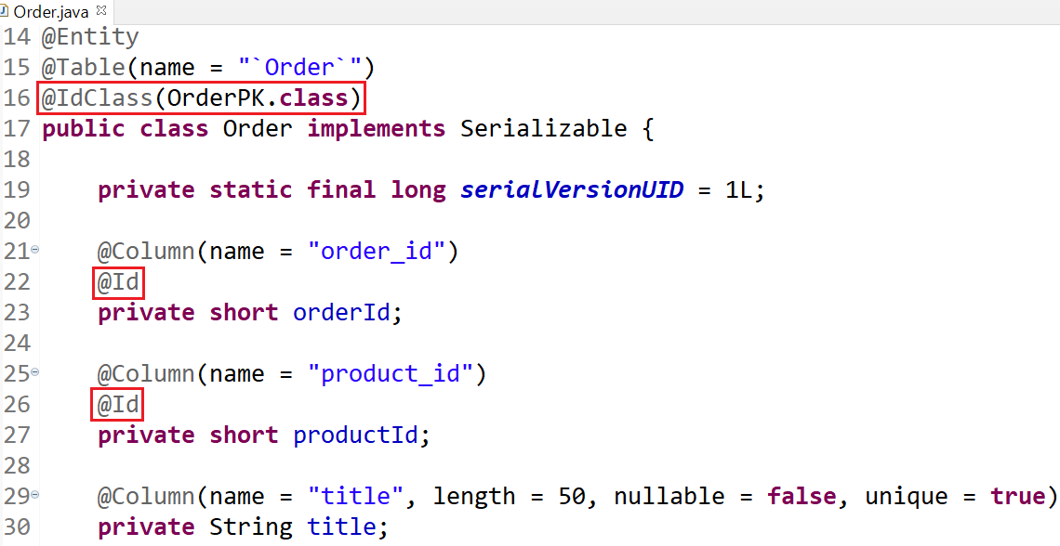
Primary key
Multiple primary key
Way 2: @Embeddable & @IdClass
Primary key Class (Similar to Way 1)
Using

Slide 35
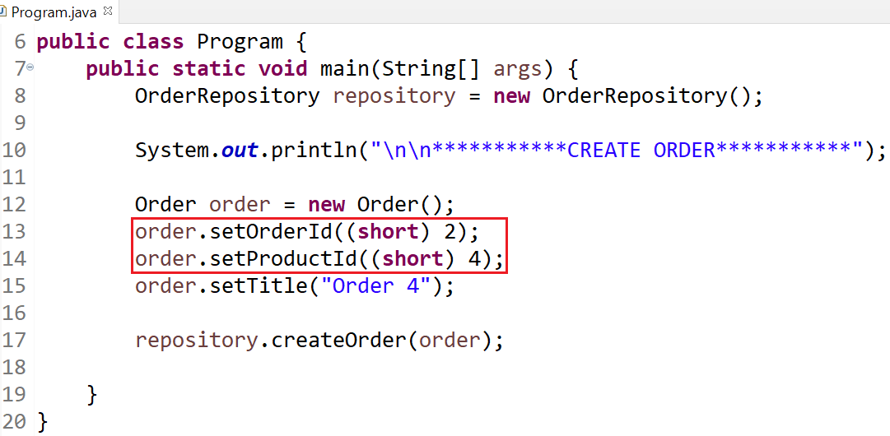
Primary key

Slide 36
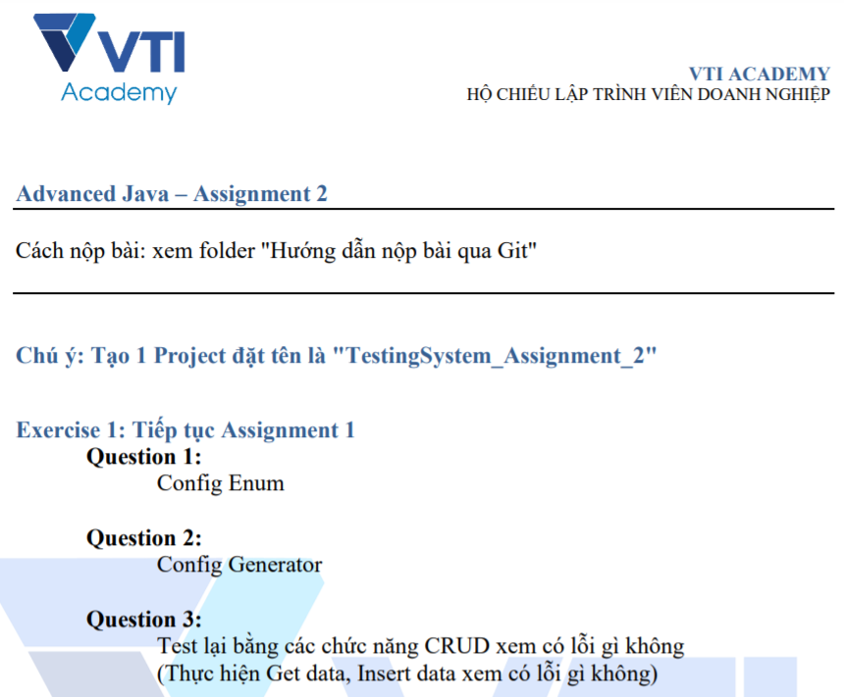
Testing System Assignments

Slide 37
Reference
https://www.javatpoint.com/hibernate-tutorial
https://www.baeldung.com/

Slide 38
Q & A
Copyright © VTI Academy All Rights Reserved

